Slide 1
Clustering and PCA
HELP International NGO Funding Investment Strategy

Slide 2
Business Objective
As CEO of the HELP International NGO needs to decide how to use $ 10 million money strategically and effectively.
There are 167 Countries out of which NGO Needs to know the Countries which are Not doing well in terms of Health and Growth (GDPP) also which has high Child_Mort rate so that the NGO can fund these countries which are in the dearest need of aid and help.

Slide 3
Analysis Approach
Importing Countries Data and Understanding it.
Cleaning the Data and Analyzing Outliers.
Applying PCA and Identifying the Components. Create a dataset with Country and PCA Components.
Check for the outliers and Cap them.
Draw Bar/linechart to check how much data is explained by Components.
Apply Hopkins algorithm to check if the PCA Component Dataset is good for Clustering or not
If the resultant number % is >75 then it is good.
Do Silhouette Analysis to identify optimal value of clusters to group the countries.
Apply Means clustering algorithm (with Number of Cluster identified) on the dataset and merge it with original Dataset of Countries.
Analyze the Clusters by visualizing it (BoxPlot/Scatterplot) and different health/Growth Measures.

Slide 4
Analysis Approach Continued …
Apply the Hieratical Clustering on the PCA Created dataset and assign the Cluster Label to each Country Data.
Merge the dataset with the original Country Dataset to analyze the Clusters with respect to Health and Growth Factors.
Create 2 columns : Child_Mort % with respect to GDPP and Health % wrt GDPP.
Report Countries which have Low GDPP/Health Ratio Or ChildMorPercent% wrt GDPP for the NGO to take necessary funding decisions.

Slide 5
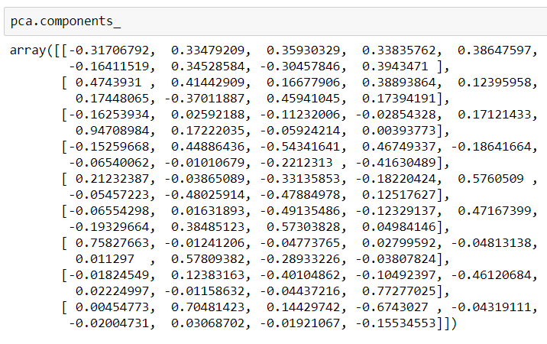

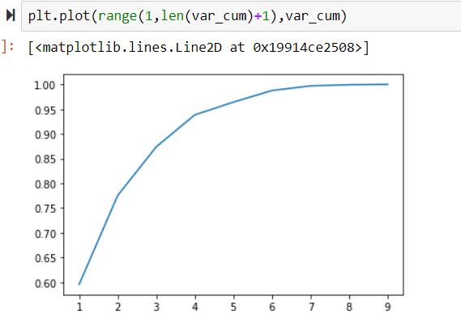
Explain the results of Principal Component Analysis and Clustering briefly
When applied PCA on 165 contries and 9 health factors. 9 principle components got generated specifying the % of data explained by each component.
explained_variance_ratio_ gives importance of components
From the above result it is shown that more than 82% of variance is explained by 5 components. Hence applied PCA with 5 components.
After PCA.Fit_transform the PCA dataset got created with 5 PC components which are not correlated with each other and are used to apply the clustering.
This data_frame is then applied to Kmeans clustering and Hierarchal clustering to group the data based on the linear combination of these 5 PC components.
Kmeans and Hieratical Clustering assigned the Clustering IDs which based on PC components

Slide 6
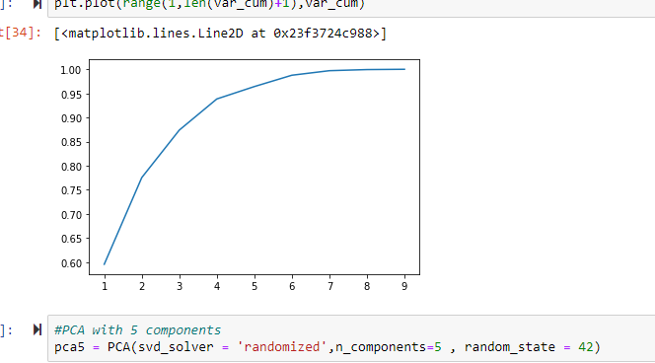
Include visualizations and summarize the most important results in the presentation
As CEO of the HELP International NGO needs to decide how to use $ 10 million money strategically and effectively.
There are 167 Countries out of which NGO Needs to know the Countries which are Not doing well in terms of Health and Growth (GDPP) also which has high Child_Mort rate so that the NGO can fund these countries which are in the dearest need of aid and help.
The first step included loading the countries and analyzing missing values, outliers , data format
There are 9 Columns and 167 countries rows in the countries.csv
There is no missing values identified
exports , imports and health is in % of GDPP hence needs to be converted to numbers.
Salary , inflation and GDPP has outliers hence caped them.
Once data is clean, the next step is to apply PCA. :
Scaled the Data to normalize via StandardScaler().fit_transform.
identified PCA Components for 9 colums and their importance by explained_variance_ratio_.
After drawing cumulative barchart, identified that 95% of data is been explained by 5 components
PC1 ,PC2 , PC3, PC4 , PC5
Created the dataframe and merged the countries to these PC components for further Clustering. df_Cont_model
Caped the outliers present for PC1 , PC2 ,PC3 , PC5

Slide 7
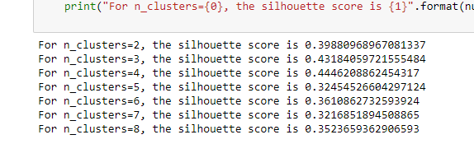
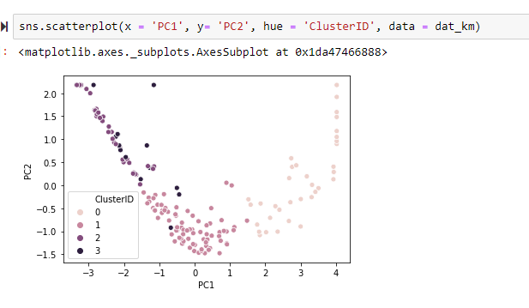
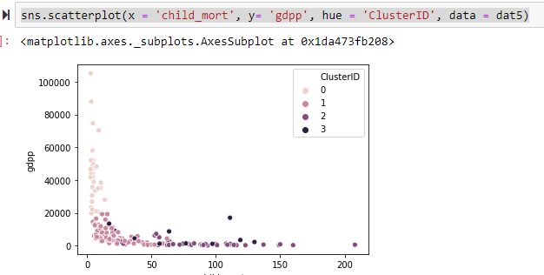
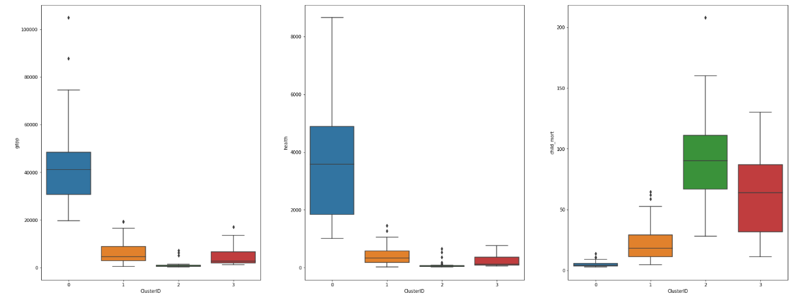
Include visualizations and summarize the most important results in the presentation
Applied Hopkins Algo and identified the dataset created is good for Clustering with the score : 82.5%
Identified Silhouette score for Optimal value of K. Took K=4
After applying the Kmeans Algo countries got grouped in 4 clusters.

Slide 8
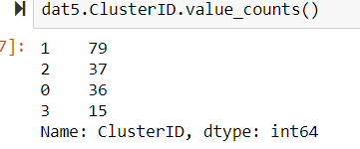
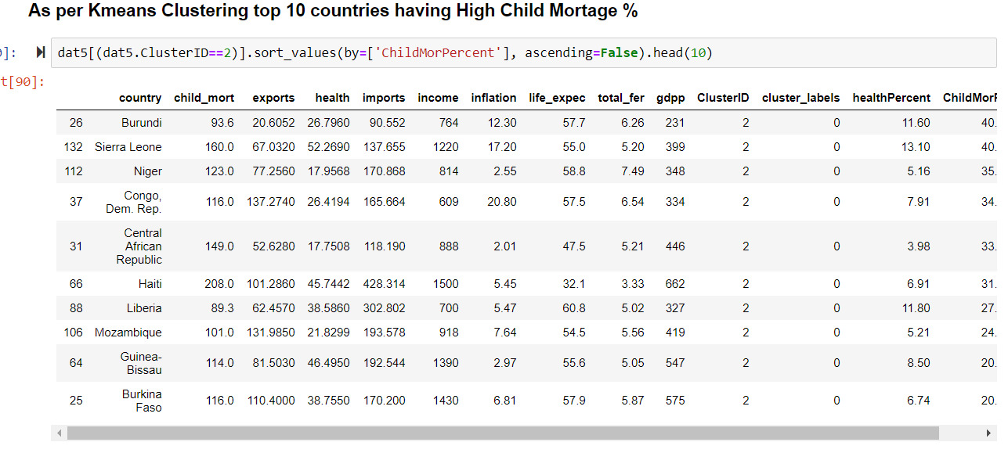
Include visualizations and summarize the most important results in the presentation
From the Boxplot it is understood that :
Cluster 2 (37 Countries) is having low GDPP , Health spend and high Child Mort. Hence the countries associated with them are very much in need.
Contries in Cluster 0 (Count - 15) have high GDPP,health and Low Child Mort hence don’t need any help.
Contries in cluster 3 has low GDPP , health and high child Mort after Cluster 2. hence can be considered as per the budget
Calculating the %health and Child_mort% Over GDPP and listing the countries having high low health% and high child_mort% lists Top contries in need and should be focused by NGO
dat5['healthPercent']=dat5['health']*100/dat5['gdpp’]
dat5['ChildMorPercent']=dat5['child_mort']*100/dat5['gdpp']

Slide 9
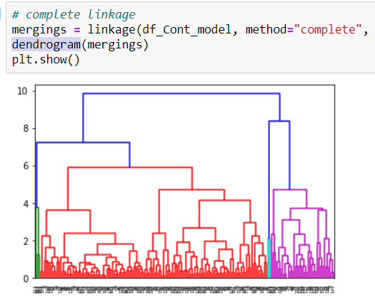
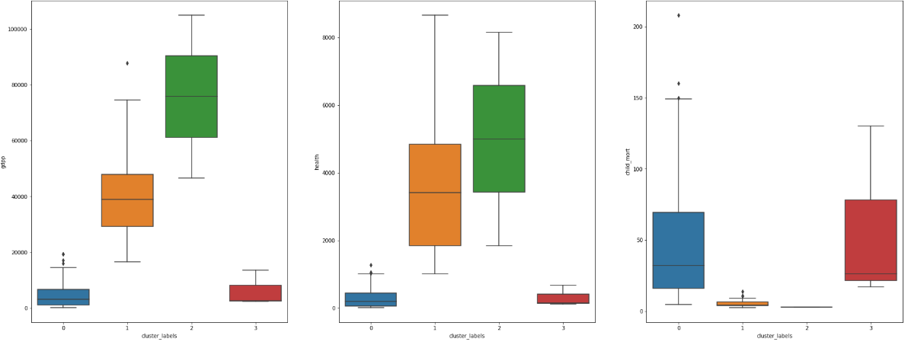
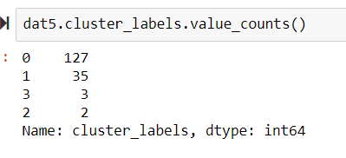
Include visualizations and summarize the most important results in the presentation
After Applying Kmeans clustering, applied Hierarchal Clustering algorithm to regroup the data and analyze the countries growth and health factors.
On the PCA applied dataset, performed the linkage and created the dendrogram to identify the ideal clusters. Cutting the graph at 75% gives 4 clusters.
Applied cut_tree function and reshaped the dataframe to map the labels with countries. Created the box plot to visualize the the clusters :
From the above box plot it is clear that cluster 0 and 2 has high child_Mort and Low GDPP/Health numbers. Hence countries in these clusters are in need of

Slide 10
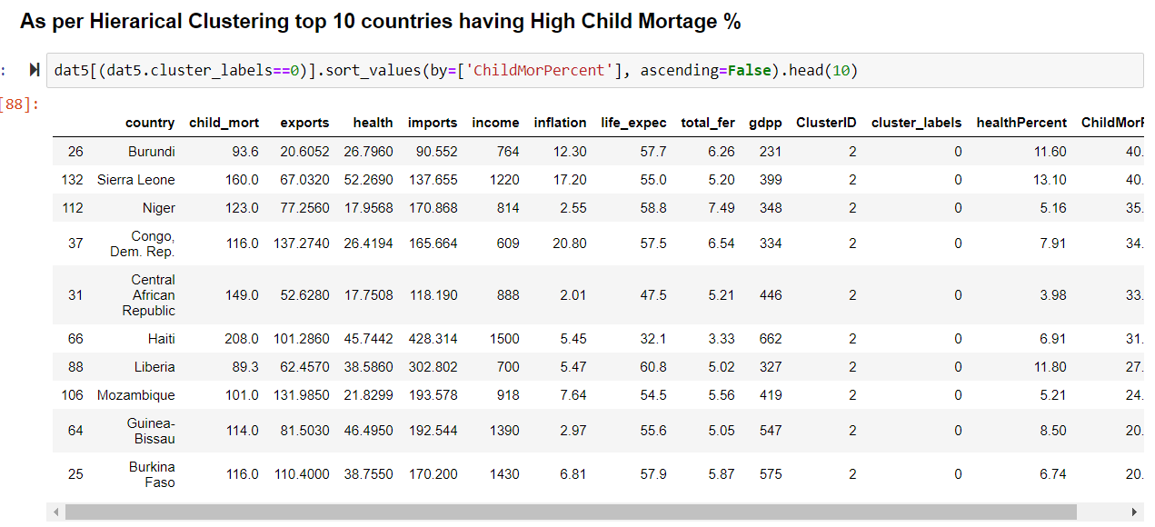
Include visualizations and summarize the most important results in the presentation
After sorting countries by child_mort% desc over GDPP, following countries comes up for NGO to focus :

Slide 11
final list of countries which need Aid:
Top 10 Countries having Low GDPP and high ChildMorPercent and hence in need of Aid
Kmeans: Top 10 out of Total 37 Countries Hierarchal : Top 10 out of Total 127 Countries
Burundi
Sierra Leone
Niger
Congo, Dem. Rep.
Central African Republic
Haiti
Liberia
Mozambique
Guinea-Bissau
Burkina Faso
Burundi
Sierra Leone
Niger
Congo, Dem. Rep.
Central African Republic
Haiti
Liberia
Mozambique
Guinea-Bissau
Burkina Faso

Slide 12
Final list of countries which need Aid:
Top 10 Countries having Low GDPP and low Health Spending and hence in need of Aid
Kmeans: Top 10 out of Total 37 Countries Hierarchal : Top 10 out of Total 127 Countries
Pakistan
Eritrea
Madagascar
Central African Republic
Benin
Lao
Comoros
Chad
Kenya
Guinea
Myanmar
Pakistan
Congo, Rep.
Turkmenistan
Indonesia
Eritrea
Oman
Angola
Sri Lanka
Seychelles

Slide 13
Thank you

